Slide 1
Mafia Management System
Daniel Schepers
Robert Fendricks
Frank Huang
Notes:
Dan

Slide 2
Problem Statement
Power of the Mafia is decreasing
Not nearly what it was in the Al Capone days
Probably caused by lack of new technology
There have been many advances in law enforcement technology, but not mafia technology
The Mafia clearly needs a quick way to manage their empire
The many aspects of a Mafia empire include: Employees, Businesses, Turfs, Projects, Prisons, and Rival Families
Notes:
RJ

Slide 3
OUR Solution
Create a web based application
Use a database to keep track of various mafia interactions and assets
Secure log in
Make sure that this application doesn’t compromise the user
Encrypt the username/password in the database
Allow employees to view the status of various projects, family rivalries, turfs, and businesses
Give the head of the family the power to control the family from the web
Create and delete projects, take turf from other families, fire employees, break employees out of prison, and control businesses and their products.
Notes:
RJ

Slide 4
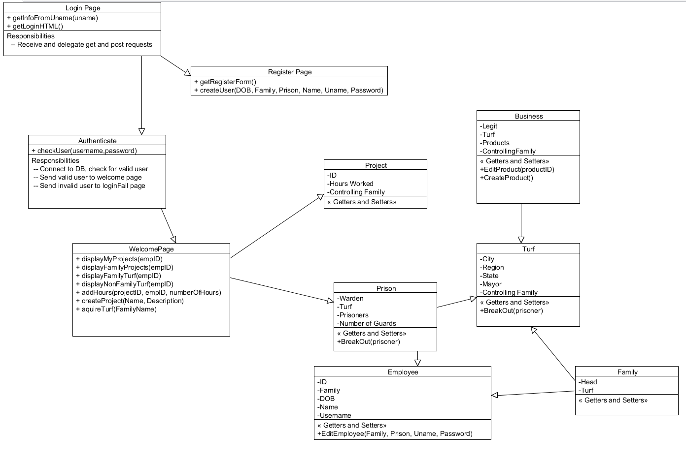

Slide 5
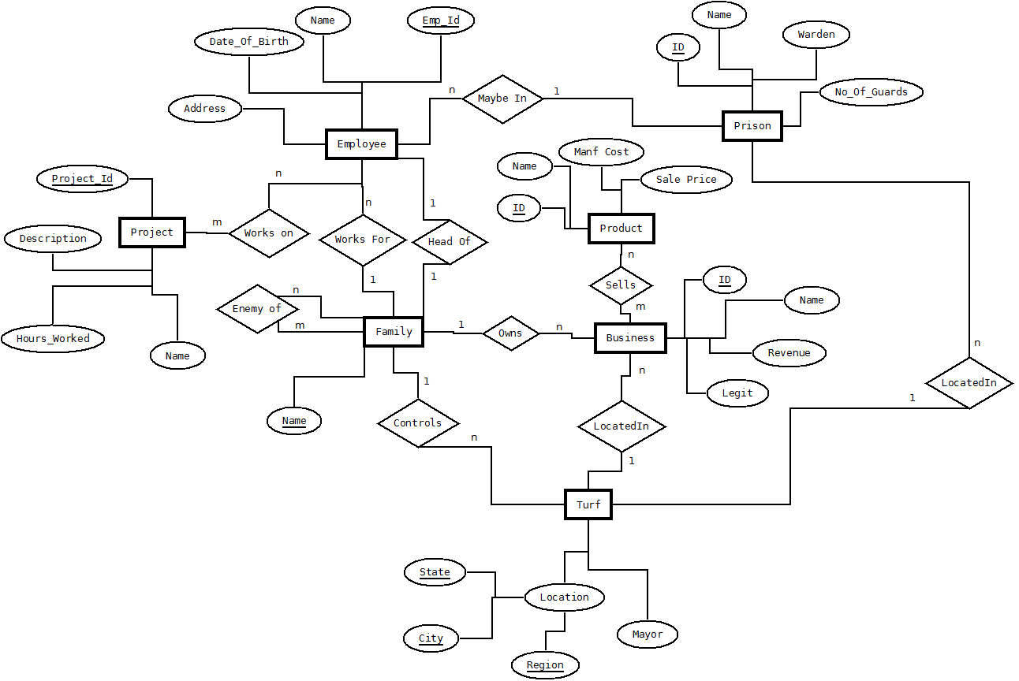
Notes:
Frank

Slide 6
Our Problems
Steep learning curve with Ruby
Ruby is new to the whole team
Pop ups
MySQL vs MSSQL
Various subtle syntax variances
No GUI – all sprocs were written via command line
Making HTML pretty
Dan isn’t a web designer
Notes:
Dan, RJ, Frank

Slide 7
Overcoming obstacles
Steep learning curve with Ruby
Stack overflow ☺
Lots and lots of trial and error
Book from Sriram
MySQL vs MSSQL
Trial and error
Google
Try it in MSSQL, then translate
Making HTML pretty
Ask Frank to make it pretty
Notes:
Dan, RJ, Frank

Slide 8
DEMO

